Slide 1
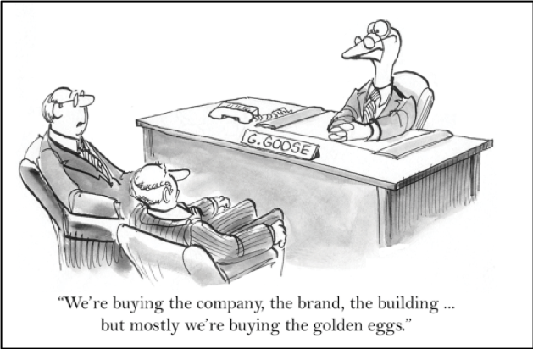
Value creation via mergers and acquisitions

Slide 2
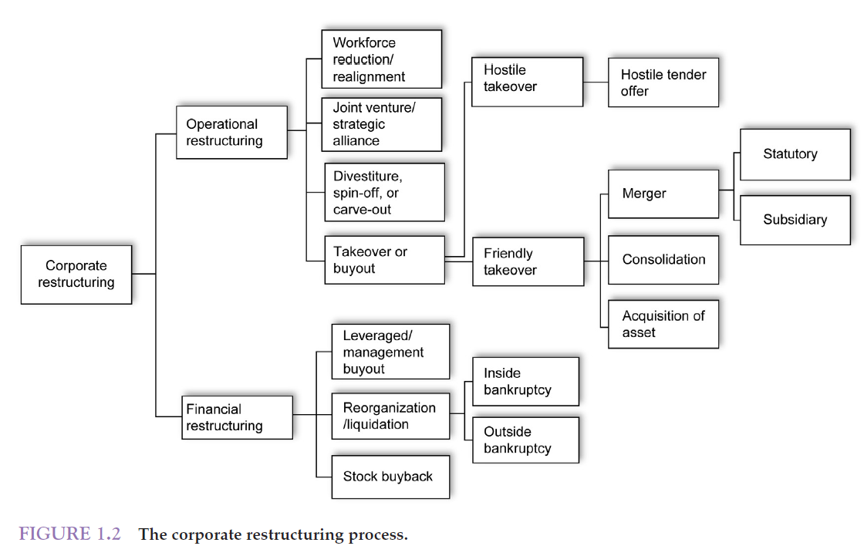
Corporate restructuring process

Slide 3
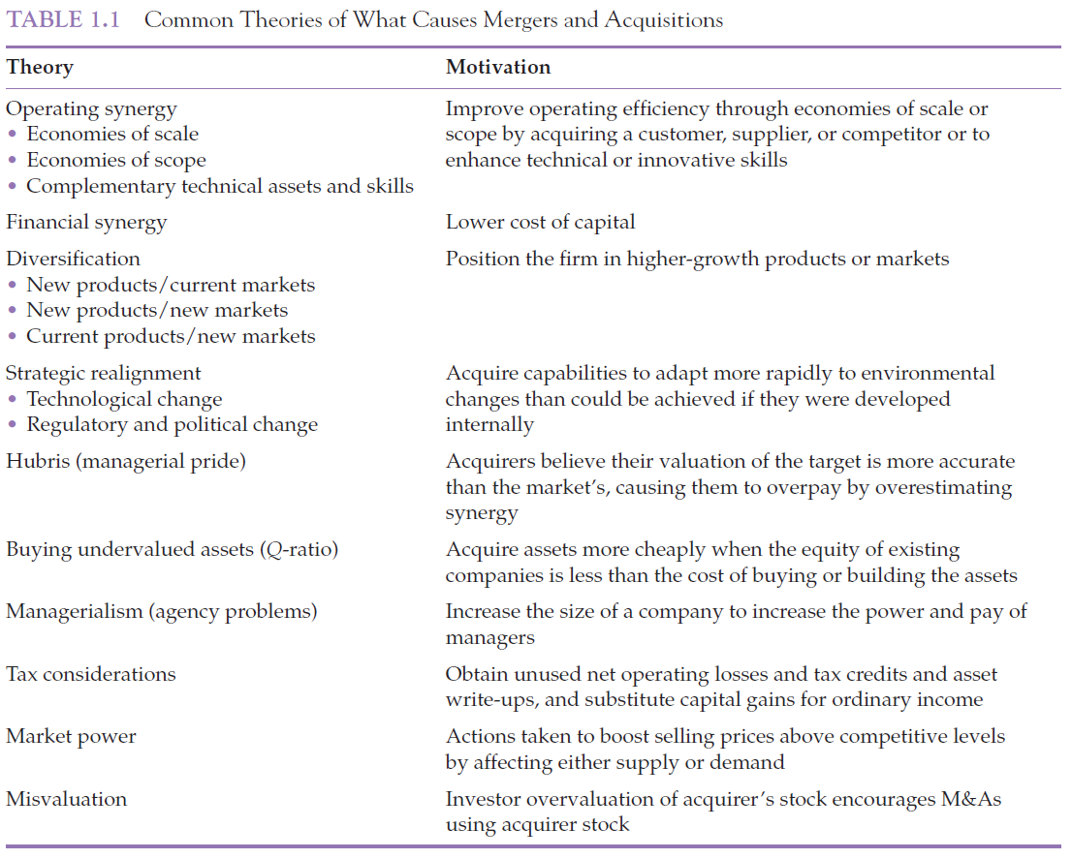
Motives for M&A

Slide 4
Synergy
Synergy implies value created by mergers; by far the most common justification for high premiums paid for bidders.
If $V_{A}$ denotes the pre-merger value of the acquirer, $V_{T}$ denotes the pre-merger value of the target, and $V_{AT}$ denotes the value of the merged firm, then
Synergy = $V_{AT}−\left(V_{A}+V_{T}\right)$.
The whole is greater than the sum of the parts!

Slide 5
Sources of synergy
Operating synergy (assets side of the balance sheet)
Revenue enhancement / Monopoly gains.
Cost reduction.
Expertise.
Financial synergy (liability side of the balance sheet)
Tax reduction.
Cost of capital reduction.

Slide 6
Revenue enhancing synergies
Combination of two firms will generate more revenue for the whole firm.
Oracle’s acquisition of Peoplesoft in 2005 hoped to combine the two product lines to allow its customers one-stop shopping. This they hoped would steal market share from competitors like SAP.
Monopoly/ Market power: If a firm acquires a large rival firm it reduces competition in the industry, potentially raising prices and profits.
Caveat: Government concerns about anti-competitive behavior.
Market dynamics. E.g., entering new markets.

Slide 7
Cost reduction synergies (1)
One of the most common reasons ― reduce overlap by laying off employees, closing offices.
Economies of scale.
The savings a large company can enjoy from producing goods in high volume, that are not available to a small company.
Economies of scope.
Savings large companies can realize that come from combining the marketing and distribution of different types of related products.
A cost associated with an increase in size (dis-economies of scale) is that larger firms are more difficult to manage.

Slide 8
Cost reduction synergies (2)
Vertical integration ― merger between firms with customer-supplier relationships, and hence coordination benefits.
Efficiency gains ― better governance.
Run the target organization more efficiently than existing management could.
This is why take-over markets serve as a disciplining mechanism.

Slide 9
Financial synergy
Target firms, unable to finance their investment opportunities (financially constrained), may view access to additional financing provided by an acquirer’s unused borrowing capacity or excess cash balance as a form of financial synergy; they increase their investment levels following acquisition. Or vice-versa.

Slide 10
Managerial motives
Managers seek to acquire firms for their own personal motives.
May pay a premium for companies for this reason.
Managers may believe their own valuations are superior to the market.
This may cause them to overpay.
Executive compensation and M&A activity.
Compensation is strongly related to firm size.

Slide 11
Empirical evidence
Overall, mergers add value, +1.35%.
Weighted average of target and acquirer returns, the weights being market values.
Though the median merger adds value, the really large mergers lose a lot of money.
While the whole maybe more than sum of parts, most of the value increase is captured by target’s shareholders.
Between 1980-2001, mergers in aggregate destroyed $226 billion for acquirers.

Slide 12
Acquisition premium
Paid by an acquirer in a takeover, it is the % difference between the acquisition price and the pre-merger price of a target firm.
Research has found that acquirers pay an average premium of 43% over the pre-merger price of the target.

Slide 13
Acquisition premium …
Why do acquirers choose to pay so large a premium?
Over-estimation of synergies.
Acquiring unrelated businesses unlikely to create value; conglomerate mergers usually fail.
Overestimation of growth; only 12% of mergers realized predicted growth.
Overestimation of cost reduction; 40% failed to achieve projected cost savings.
Underestimation of implementation/integration difficulties.

Slide 14
Acquisition premium …
Why do acquirers choose to pay so large a premium?
Managerial incentives.
Empire building (ego/prestige): Managers may prefer to run a larger company. Or it may be compensation driven.
Undiversified managers benefit personally from a diversifying acquisition.
Acquire to reduce risk of losing their jobs by lowering likelihood of bankruptcy.
Hubris: Overconfident CEOs pursue mergers that have low chance of creating value because they believe that their ability to manage is great enough to succeed.

Slide 15
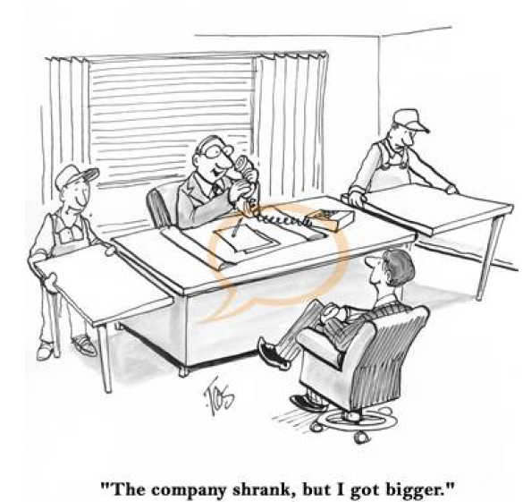
Acquisition premium …

Slide 16
When do mergers create value?
Have a clear growth strategy with focus on source of value creation: Relatedness and adherence to value creative strategy.
Identify specific value drivers ― main source of synergy ― revenue increase or cost saving?
Be careful of unrelated diversification, size maximization, and empire building.
Incorporate cost of implementation and integration with main focus on human and physical resources cost.
Do legal and other due diligence.
Know when and be ready to walk away.

Slide 17
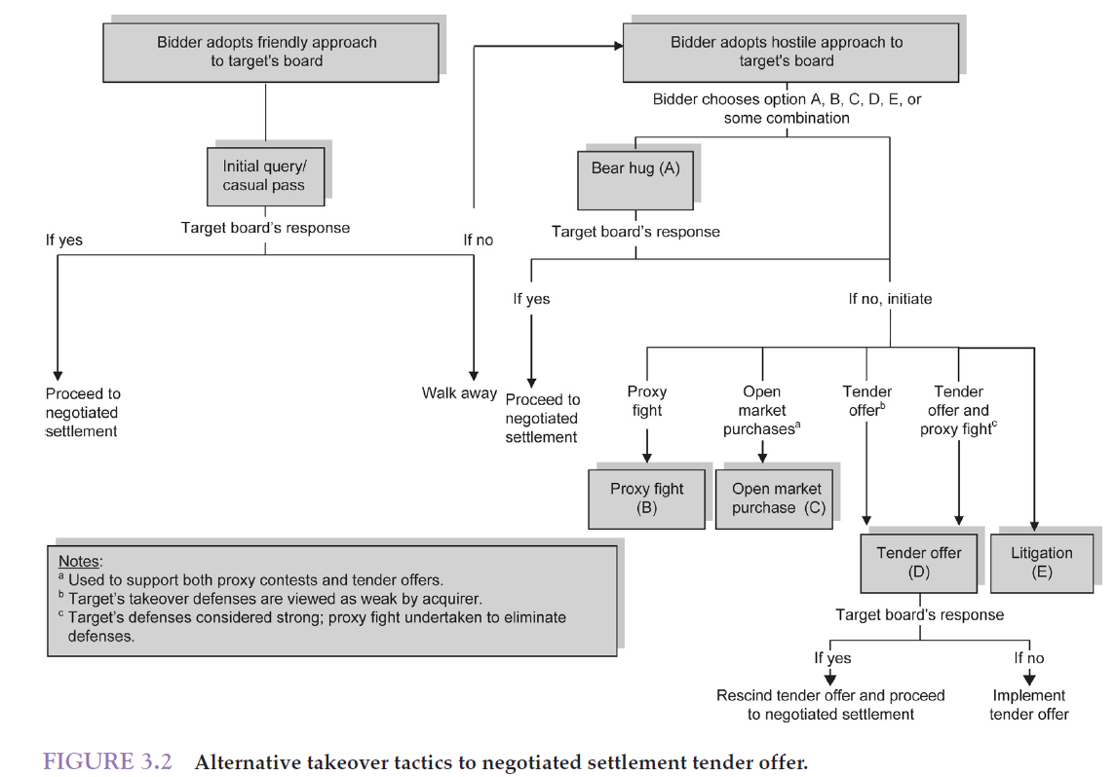
Takeover tactics
Takeover tactics

Slide 18
Takeover tactics …
Takeover tactics
Friendly deals (Target board supports bid).
Hostile deals (Target board contests bid) More difficult (therefore, rarer) due to:
Target board flexibility in setting up defenses.
Impact on bid premiums.
Impact on post-closing integration.
The threat of hostile bids often moves target boards toward negotiated settlements.

Slide 19
Friendly takeover tactics
Friendly takeover tactics
Potential acquirer obtains support from the target’s board and management early in the takeover process before proceeding to a negotiated settlement.
The acquirer and target firms often enter into a standstill agreement in which the bidder agrees not to make any further investments for a stipulated period in exchange for a break-up fee from the target firm.

Slide 20
Friendly takeovers
Friendly takeover tactics
Such takeovers are desirable as they avoid an auction environment.
If the bidder is rebuffed, the loss of surprise gives the target firm time to mount additional takeover defenses.

Slide 21
Hostile takeover tactics (1)
Hostile takeover tactics
Limiting the target’s actions through a bear hug.
Bear hug letters are formal proposals to a target’s board demanding an immediate response and intended to pressure the board to accept the proposal by making large shareholders, arbs, hedge funds and other institutional shareholders aware of the proposal.
Once the bid is made public, institutional investors and arbitrageurs add to the pressure by lobbying the board to accept the offer.
The accumulation of stock by arbs makes purchases of blocks of stock by the bidder easier, as they often are quite willing to sell their shares (at a premium over the price they paid).
Notes:
.

Slide 22
Hostile takeover tactics (2)
Hostile takeover tactics
Proxy contests in support of a takeover.
A proxy contest is an activity initiated by a dissident shareholder who requests other shareholders grant her the right to vote their shares for a single vote often to remove directors, rescind the firm’s defenses, to pressure the board to accept a takeover bid, etc.
Potential acquirer appoints its slate of directors and urges shareholder to elect them.
The potential acquirer may want to change just a few policies or remove management.
Proxy contests have low success rates.

Slide 23
Hostile takeover tactics (2 …)
Hostile takeover tactics
Impact of proxy contests on share price.
Despite a low success rate, proxy fights often result in positive abnormal returns to target shareholders regardless of the outcome. The reasons include the eventual change in management at firms embroiled in proxy fights, the tendency for new management to restructure the firm, investor expectations of a future change in control, and special cash payouts made by firms with excess cash holdings. However, when management wins by a wide margin, shareholder value often declines, since little changes in how the firm is managed.

Slide 24
Hostile takeover tactics (3)
Hostile takeover tactics
Purchasing target stock in the open market.
Purchasing stock in the public markets is intended to enable an acquirer to accumulate up to 4.99% of the voting shares of a target company at a comparatively low price before publicly filing with the SEC its intentions in the form of a 13D filing. This action enables an acquirer to accumulate some voting shares without making their intentions public and, in the event of an unsuccessful takeover bid, to recover some portion of the takeover costs by selling their target shares to the winning bidder.

Slide 25
Hostile takeover tactics (4)
Hostile takeover tactics
Circumventing the target’s board through a tender offer.
Tender offers are those made directly to a firm’s shareholders to get their approval of a takeover bid when the target firm’s board has failed to accept the proposed bid. Tenders offers may not necessarily imply hostile action on the part of the bidder but may reflect an effort to complete the transaction more rapidly than may be achieved using a merger.

Slide 26
Hostile takeover tactics (5)
Hostile takeover tactics
Litigation.
Litigation is intended to pressure the board into accepting a takeover bid. The target firm’s boards often are accused of not acting in the best interests of their shareholders or refusing to rescind what are arguably impenetrable defenses.

Slide 27
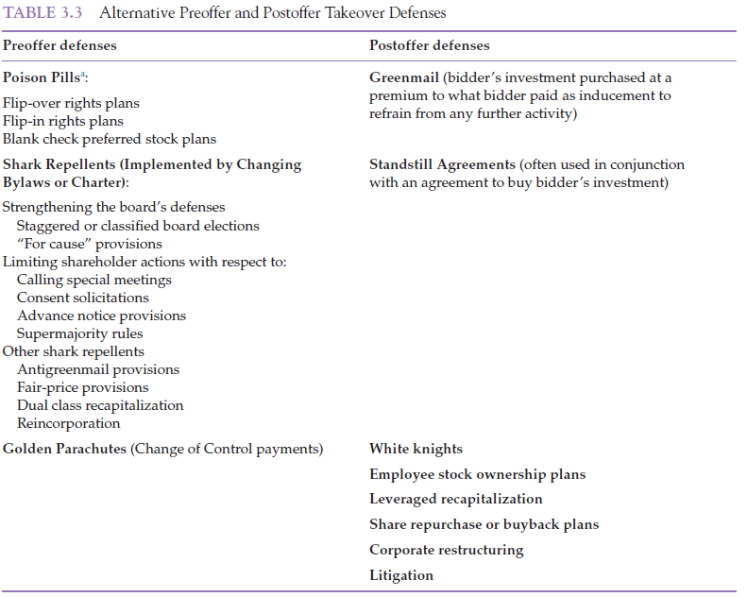
Takeover defenses …
Takeover defenses

Slide 28
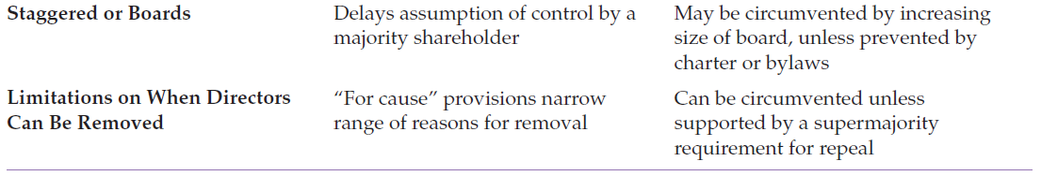
Shark repellants: Board defenses
Pre-offer takeover defenses

Slide 29
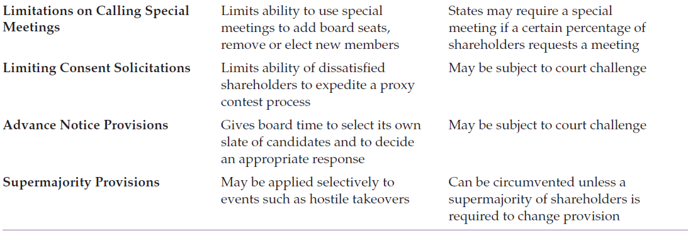
Shark repellants: Shareholder actions
Pre-offer takeover defenses

Slide 30
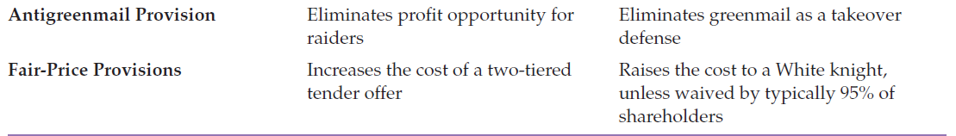
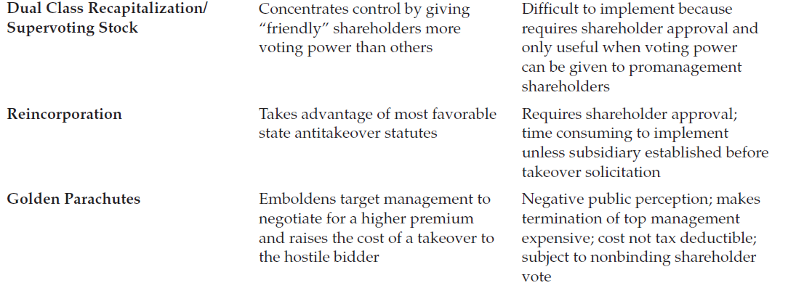
Shark repellants: Others
Pre-offer takeover defenses
Greenmail refers to an activist investor taking a minority position in the stock of a particular firm and subsequently demanding that their shares be repurchased at a premium with a thinly disguised threat that failure to do so could result in the investor taking control of the firm and subsequently removing management and board members

Slide 31
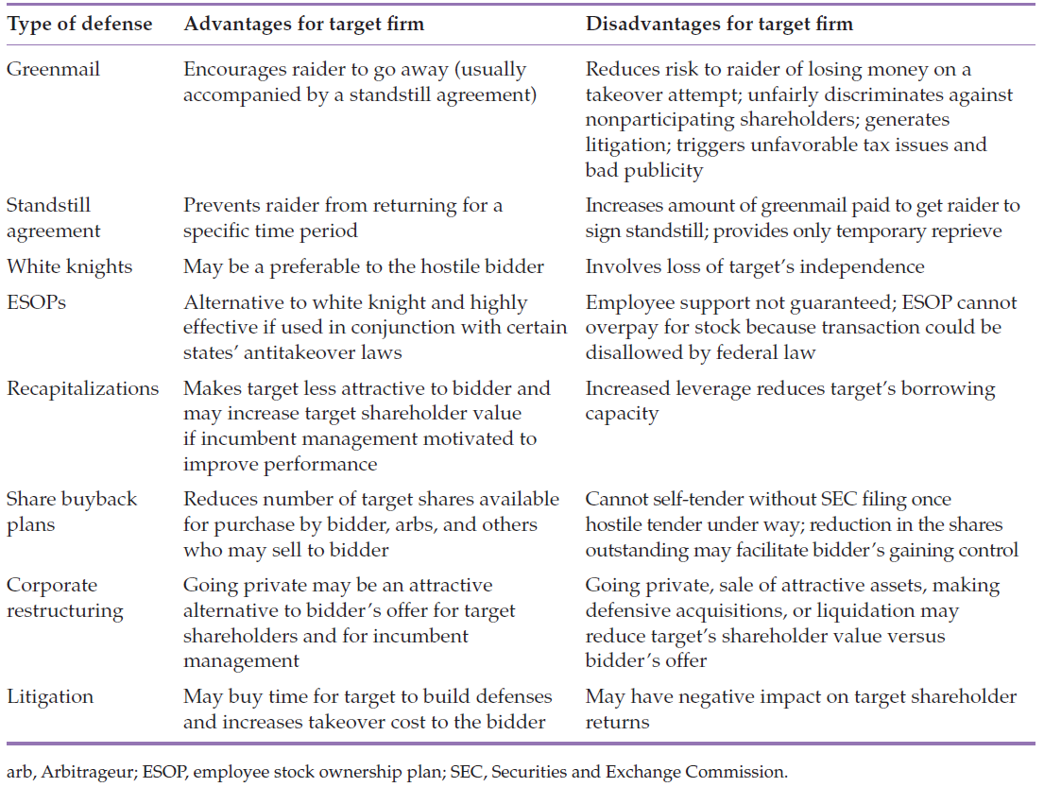
Post-offer takeover defenses
Post-offer takeover defenses

Slide 32
Deal structuring
Form of payment.
Cash vs. Stock.
Risk mitigation.

Slide 33
Form of payment – Types
Cash (simple but creates immediate seller tax liability).
Non-cash.
Common equity (possible EPS dilution but defers tax liability).
Preferred equity (lower shareholder risk in liquidation).
Convertible preferred stock (includes attributes of common and preferred stock).
Debt (secured and unsecured; lower risk in liquidation).

Slide 34
Cash vs. stock
Should the acquirer use cash or stock?
Should the target prefer cash or stock?
Some considerations:
Asymmetric information
Adverse selection
Lemons problem
Pre-emption
Incentives

Slide 35
Form of payment – Risk mitigation
Earn-outs or contingent payments.
Rights, royalties, and fees.
Collar arrangements.

Slide 36
Earn-outs
Earnouts and warrants frequently are used whenever the buyer and the seller cannot agree on price or when the parties involved wish to participate in the upside potential of the business.
An earnout agreement is a financial contract whereby a portion of the purchase price of a company is to be paid in the future, contingent on realizing the future earnings level or some other performance measure agreed on earlier.

Slide 37
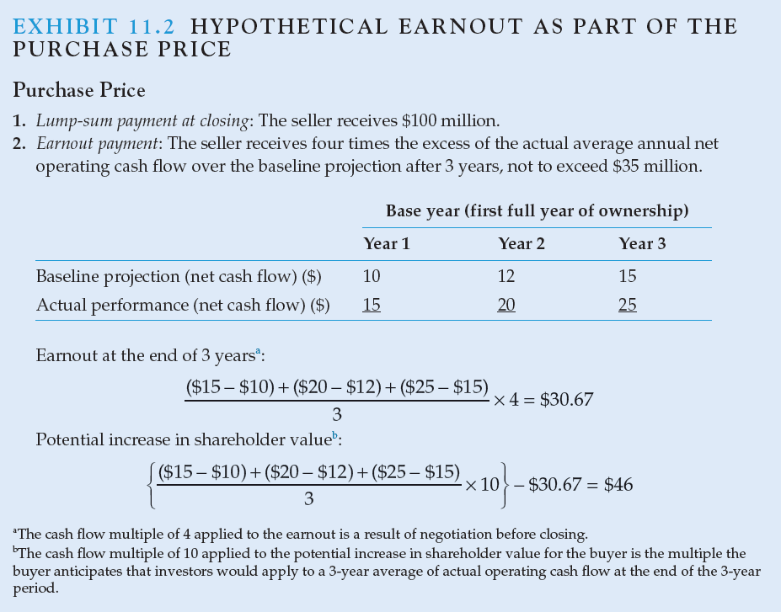
Earn-outs example

